Slide 1
Activation Functions

Slide 2
Outline
What is an Activation Function?
Why do we use an Activation Function?
Types of Activation Functions

Slide 3
What is an Activation Function?
The activation function of a node in an artificial neural network is a function that calculates the output of the node based on its individual inputs and their weights.

Slide 4
What is an Activation Function?
Activation functions apply a non-linear transformation and decide whether a neuron should be activated or not

Slide 5


$${Input: x}_{1}$$
$${ x}_{1}$$
Input Layer
Hidden Layer
Output Layer

Slide 6





$$Weights: w_{11},w_{12} ,w_{2},w_{3}$$
$$w_{11}$$
$$w_{2}$$
$${Input: x}_{1}$$
$${ x}_{1}$$
$$w_{12}$$
$$w_{3}$$
Input Layer
Hidden Layer
Output Layer

Slide 7







$$b$$
$$b_{11}$$
$$Weights: w_{11},w_{12} ,w_{2},w_{3}$$
$$Biases: b_{11},b_{12},b_{2}$$
$$w_{11}$$
$$w_{2}$$
$${Input: x}_{1}$$
$${ x}_{1}$$
$$w_{12}$$
$$w_{3}$$
$$b_{2}$$
$$b$$
$$b_{12}$$
$$b$$
Input Layer
Hidden Layer
Output Layer

Slide 8



$$b$$
$$b_{11}$$
$$z_{1}= w_{11} x_{1}+b_{11}$$
$$z_{1}$$
$$w_{11}$$
$$w_{2}$$
$${Input: x}_{1}$$
$${ x}_{1}$$
$$w_{12}$$
$$w_{3}$$
$$b_{2}$$
$$b$$
$$b_{12}$$
$$b$$

Slide 9



$$b$$
$$b_{11}$$
$$z_{1}= w_{11} x_{1}+b_{11}$$
$$z_{1}$$
$$w_{11}$$
$$w_{2}$$
$${Input: x}_{1}$$
$${ x}_{1}$$
$$w_{12}$$
$$w_{3}$$
$$z_{2}$$
$$b_{2}$$
$$b$$
$$b_{12}$$
$$b$$
$$z_{2}= w_{12} x_{1}+b_{12}$$

Slide 10







$$b$$
$$b_{11}$$
$$z_{1}= w_{11} x_{1}+b_{11}$$
$$z_{1}$$
$$h_{1}$$
$$h_{1}= σ(z_{1})$$
$$w_{11}$$
$$w_{2}$$
$${Input: x}_{1}$$
$${ x}_{1}$$
$$w_{12}$$
$$w_{3}$$
$$z_{2}$$
$$b_{2}$$
$$b$$
$$b_{12}$$
$$b$$
$$z_{2}= w_{12} x_{1}+b_{12}$$

Slide 11








$$b$$
$$b_{11}$$
$$z_{1}= w_{11} x_{1}+b_{11}$$
$$z_{1}$$
$$h_{1}$$
$$h_{1}= σ(z_{1})$$
$$w_{11}$$
$$w_{2}$$
$${Input: x}_{1}$$
$${ x}_{1}$$
$$w_{3}$$
$$w_{12}$$
$$z_{2}$$
$$h_{2}$$
$$b_{2}$$
$$b$$
$$b_{12}$$
$$b$$
$$h_{2}= σ(z_{2})$$
$$z_{2}= w_{12} x_{1}+b_{12}$$

Slide 12




$$b$$
$$b_{11}$$
$$z_{1}$$
$$h_{1}$$
$$z_{3}= h_{1} w_{2}+h_{2} w_{3}+b_{2}$$
$$w_{11}$$
$$w_{2}$$
$${Input: x}_{1}$$
$${ x}_{1}$$
$$z_{3}$$
$$w_{3}$$
$$w_{12}$$
$$z_{2}$$
$$h_{2}$$
$$b_{2}$$
$$b$$
$$b_{12}$$
$$b$$

Slide 13
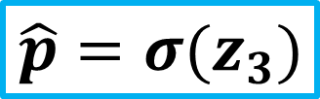




$$b$$
$$b_{11}$$
$$z_{1}$$
$$h_{1}$$
$$w_{11}$$
$$w_{2}$$
$${Input: x}_{1}$$
$${ x}_{1}$$
$$z_{3}$$
$$\hat{p}$$
$$w_{3}$$
$$\hat{p}=σ(z_{3})$$
$$w_{12}$$
$$z_{2}$$
$$h_{2}$$
$$b_{2}$$
$$b$$
$$b_{12}$$
$$b$$

Slide 14

Rectified Linear Unit (ReLU)
$$f\left(x\right)=max⁡(0,x)$$
Most popular choice for hidden layers
It takes the maximum of 0 and input x
If the input is negative, it outputs 0.
If the input is positive, it simply returns it without modification.

Slide 15

When to use ReLU?
$$f\left(x\right)=max⁡(0,x)$$
The rule of thumb is if you are not sure which activation function to use in your hidden layers then just use ReLU.

Slide 16
$$b$$
$$b_{11}$$
$$Weights: w_{11},w_{12} ,w_{2},w_{3}$$
$$Biases: b_{11},b_{12},b_{2}$$
$$w_{11}$$
$$w_{2}$$
$${Input: x}_{1}$$
$${ x}_{1}$$
$$w_{12}$$
$$w_{3}$$
$$b_{2}$$
$$b$$
$$b_{12}$$
$$b$$
Input Layer
Hidden Layer
Output Layer

Slide 17






$$b$$
$$???$$
$$Weights: w_{11},w_{12} ,w_{2},w_{3}$$
$$Biases: b_{11},b_{12},b_{2}$$
$$???$$
$$???$$
$${Input: x}_{1}$$
$${ x}_{1}$$
$$w_{12}$$
$$???$$
$$???$$
$$b$$
$$???$$
$$b$$
Input Layer
Hidden Layer
Output Layer

Slide 18







$$b$$
$$−0.85$$
$$1.70$$
$$−40.8$$
$${Input: x}_{1}$$
$${ x}_{1}$$
$$12.6$$
$$2.70$$
$$−16$$
$$b$$
$$0.00$$
$$b$$
Input Layer
Hidden Layer
Output Layer

Slide 19

$$b$$
$$−0.85$$
$$1.70$$
$$−40.8$$
$$0$$
$$12.6$$
$$2.70$$
$$−16$$
$$b$$
$$0.00$$
$$b$$
Input Layer
Hidden Layer
Output Layer

Slide 20

$$b$$
$$−0.85$$
$$z_{1}= w_{11} x_{1}+b_{11}$$
$$z_{1}$$
$$1.70$$
$$−40.8$$
$$0$$
$$12.6$$
$$2.70$$
$$−16$$
$$b$$
$$0.00$$
$$b$$
Input Layer
Hidden Layer
Output Layer

Slide 21

$$b$$
$$−0.85$$
$$z_{1}=1.70 ×0+(−0.85)$$
$$z_{1}$$
$$1.70$$
$$−40.8$$
$$0$$
$$12.6$$
$$2.70$$
$$−16$$
$$b$$
$$0.00$$
$$b$$
Input Layer
Hidden Layer
Output Layer

Slide 22

$$b$$
$$−0.85$$
$$z_{1}=−0.85$$
$$z_{1}$$
$$1.70$$
$$−40.8$$
$$0$$
$$12.6$$
$$2.70$$
$$−16$$
$$b$$
$$0.00$$
$$b$$
Input Layer
Hidden Layer
Output Layer

Slide 23






$$b$$
$$−0.85$$
$$z_{1}=−0.85$$
$$z_{1}$$
$$h_{1}$$
$$h_{1}=max(0,z_{1})$$
$$1.70$$
$$−40.8$$
$$h_{1}=max(0,−0.85)$$
$${Input: x}_{1}$$
$${ x}_{1}$$
$$2.70$$
$$12.6$$
$$−16$$
$$b$$
$$0.00$$
$$b$$

Slide 24






$$b$$
$$−0.85$$
$$h_{1}=max(0,z_{1})$$
$$z_{1}$$
$$h_{1}$$
$$h_{1}=max(0,−0.85)$$
$$1.70$$
$$−40.8$$
$$h_{1}=0$$
$${Input: x}_{1}$$
$${ x}_{1}$$
$$2.70$$
$$12.6$$
$$z_{2}$$
$$−16$$
$$b$$
$$0.00$$
$$b$$

Slide 25



$$b$$
$$−0.85$$
$$z_{1}$$
$$h_{1}$$
$$h_{1}=0$$
$$1.70$$
$$−40.8$$
$${Input: x}_{1}$$
$${ x}_{1}$$
$$2.70$$
$$12.6$$
$$z_{2}$$
$$−16$$
$$b$$
$$0.00$$
$$b$$
$$z_{2}= w_{12} x_{1}+b_{12}$$

Slide 26



$$b$$
$$−0.85$$
$$z_{1}$$
$$h_{1}$$
$$h_{1}=0$$
$$1.70$$
$$−40.8$$
$${Input: x}_{1}$$
$${ x}_{1}$$
$$2.70$$
$$12.6$$
$$z_{2}$$
$$−16$$
$$b$$
$$0.00$$
$$b$$
$$z_{2}=12.6 ×0+0$$

Slide 27



$$b$$
$$−0.85$$
$$z_{1}$$
$$h_{1}$$
$$h_{1}=0$$
$$1.70$$
$$−40.8$$
$${Input: x}_{1}$$
$${ x}_{1}$$
$$2.70$$
$$12.6$$
$$z_{2}$$
$$−16$$
$$b$$
$$0.00$$
$$b$$
$$z_{2}=0$$

Slide 28




$$b$$
$$−0.85$$
$$z_{1}$$
$$h_{1}$$
$$h_{1}=0$$
$$1.70$$
$$−40.8$$
$${Input: x}_{1}$$
$${ x}_{1}$$
$$2.70$$
$$12.6$$
$$z_{2}$$
$$h_{2}$$
$$−16$$
$$b$$
$$b$$
$$z_{2}=0$$
$$h_{2}=max(0,z_{2})$$

Slide 29




$$b$$
$$−0.85$$
$$z_{1}$$
$$h_{1}$$
$$h_{1}=0$$
$$1.70$$
$$−40.8$$
$${Input: x}_{1}$$
$${ x}_{1}$$
$$2.70$$
$$12.6$$
$$z_{2}$$
$$h_{2}$$
$$−16$$
$$b$$
$$b$$
$$h_{2}=max(0,0)$$
$$h_{2}=0$$

Slide 30



$$b$$
$$−0.85$$
$$z_{1}$$
$$h_{1}$$
$$h_{1}=0$$
$$1.70$$
$$−40.8$$
$${Input: x}_{1}$$
$${ x}_{1}$$
$$2.70$$
$$12.6$$
$$z_{2}$$
$$h_{2}$$
$$−16$$
$$b$$
$$b$$
$$h_{2}=0$$

Slide 31


$$b$$
$$−0.85$$
$$h_{1}=0$$
$$z_{1}$$
$$h_{1}$$
$$1.70$$
$$−40.8$$
$${Input: x}_{1}$$
$${ x}_{1}$$
$$z_{3}$$
$$2.70$$
$$12.6$$
$$z_{2}$$
$$h_{2}$$
$$−16$$
$$b$$
$$b$$
$$h_{2}=0$$

Slide 32
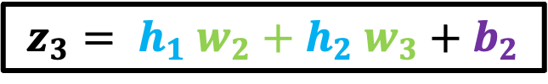
$$b$$
$$−0.85$$
$$h_{1}=0$$
$$z_{1}$$
$$h_{1}$$
$$1.70$$
$$−40.8$$
$${Input: x}_{1}$$
$${ x}_{1}$$
$$z_{3}$$
$$2.70$$
$$12.6$$
$$z_{2}$$
$$h_{2}$$
$$−16$$
$$b$$
$$b$$
$$h_{2}=0$$
$$z_{3}= h_{1} w_{2}+h_{2} w_{3}+b_{2}$$

Slide 33

$$b$$
$$−0.85$$
$$h_{1}=0$$
$$z_{1}$$
$$h_{1}$$
$$1.70$$
$$−40.8$$
$${Input: x}_{1}$$
$${ x}_{1}$$
$$z_{3}$$
$$2.70$$
$$12.6$$
$$z_{2}$$
$$h_{2}$$
$$−16$$
$$b$$
$$b$$
$$h_{2}=0$$
$$z_{3}=0 ×−40.8+0×2.70+(−16)$$

Slide 34

$$b$$
$$−0.85$$
$$z_{1}$$
$$h_{1}$$
$$1.70$$
$$−40.8$$
$${Input: x}_{1}$$
$${ x}_{1}$$
$$z_{3}$$
$$2.70$$
$$12.6$$
$$z_{2}$$
$$h_{2}$$
$$−16$$
$$b$$
$$b$$
$$z_{3}=−16$$

Slide 35
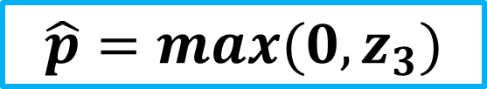
$$b$$
$$−0.85$$
$$z_{1}$$
$$h_{1}$$
$$1.70$$
$$\hat{p}=max(0,z_{3})$$
$$−40.8$$
$${Input: x}_{1}$$
$${ x}_{1}$$
$$z_{3}$$
$$\hat{p}$$
$$2.70$$
$$12.6$$
$$z_{2}$$
$$h_{2}$$
$$−16$$
$$b$$
$$b$$
$$z_{3}=−16$$

Slide 36
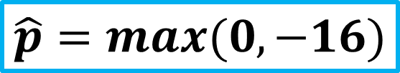
$$b$$
$$−0.85$$
$$z_{1}$$
$$h_{1}$$
$$1.70$$
$$\hat{p}=max(0,−16)$$
$$−40.8$$
$${Input: x}_{1}$$
$${ x}_{1}$$
$$z_{3}$$
$$\hat{p}$$
$$2.70$$
$$12.6$$
$$z_{2}$$
$$h_{2}$$
$$−16$$
$$b$$
$$b$$
$$z_{3}=−16$$

Slide 37
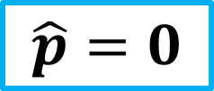
$$b$$
$$−0.85$$
$$z_{1}$$
$$h_{1}$$
$$1.70$$
$$\hat{p}=0$$
$$−40.8$$
$${Input: x}_{1}$$
$${ x}_{1}$$
$$z_{3}$$
$$\hat{p}$$
$$2.70$$
$$12.6$$
$$z_{2}$$
$$h_{2}$$
$$−16$$
$$b$$
$$b$$

Slide 38
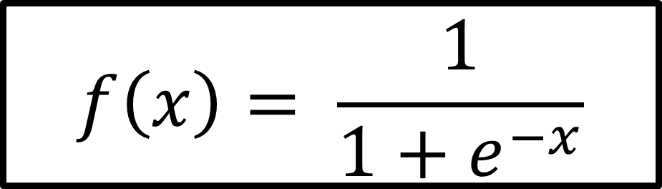
Sigmoid
$$f\left(x\right)= \frac{1}{1+e^{−x}}$$
Outputs a probability between 0 and 1
If the input is a very negative number, sigmoid outputs a number close to 0
If the input is a very positive number, sigmoid transforms it to a number close to 1
The more the positive the input number is, the more our neuron will be activated.

Slide 39
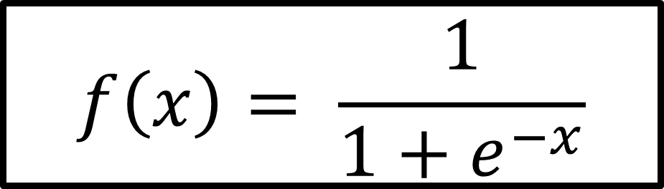
When to use Sigmoid?
$$f\left(x\right)= \frac{1}{1+e^{−x}}$$
Sometimes used in hidden layers.
Most of the time, it is used in the last layer for binary classification problems.

Slide 40
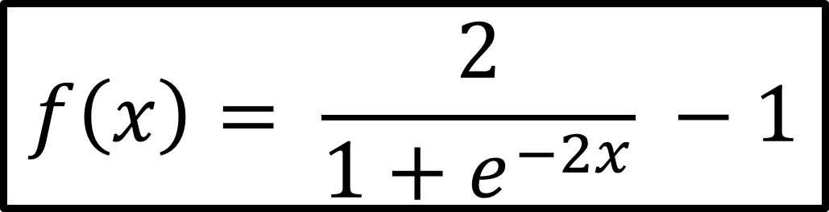
TanH (Hyperbolic Tangent)
$$f\left(x\right)= \frac{2}{1+e^{−2x}} −1$$
Basically a scaled and shifted sigmoid function
Outputs a number between -1 and +1

Slide 41
When to use TanH?
$$f\left(x\right)= \frac{2}{1+e^{−2x}} −1$$
Sometimes used in hidden layers.
Most of the time, it is used in the last layer for binary classification problems.

Slide 42
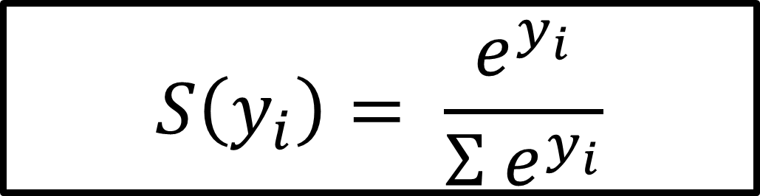
Softmax
$$S\left(y_{i}\right)= \frac{e^{y_{i}}}{{Σ e}^{y_{i}}}$$
Transforms the input to output a probability number between 0 and 1
The higher the input number, the higher will be the probability value

Slide 43
When to use Softmax?
$$S\left(y_{i}\right)= \frac{e^{y_{i}}}{{Σ e}^{y_{i}}}$$
It is usually used in the last layer in multi-class classification problems
Softmax decides for the class with the highest probability

Slide 44












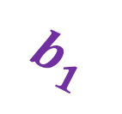


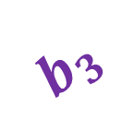






$$b$$
$$b_{1}$$
$${ x}_{1}$$
$${ z}_{1}$$
$$w_{31}$$
$${ z}_{3}$$
ReLU
$$w_{11}$$
$$w_{32}$$
$$w_{12}$$
$$w_{33}$$
$${ z}_{4}$$
$$w_{21}$$
$$w_{41}$$
$$w_{42}$$
$${ x}_{2}$$
$${ z}_{2}$$
$${ z}_{5}$$
ReLU
$$w_{22}$$
$$w_{43}$$
$$b_{2}$$
$$b_{3}$$
$$b$$
$$b$$
Input Layer
Hidden Layer
Output Layer

Slide 45






$$b$$
$$b_{1}$$
$${ x}_{1}$$
$${ z}_{1}$$
$$w_{31}$$
$${ z}_{3}$$
ReLU
$$w_{11}$$
$$w_{32}$$
$$w_{12}$$
$$w_{33}$$
$${ z}_{4}$$
$$w_{21}$$
$$w_{41}$$
$$w_{42}$$
$${ x}_{2}$$
$${ z}_{2}$$
$${ z}_{5}$$
ReLU
$$w_{22}$$
$$w_{43}$$
$$b_{2}$$
$$b_{3}$$
$$b$$
$$b$$
Input Layer
Hidden Layer
Output Layer

Slide 46
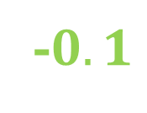
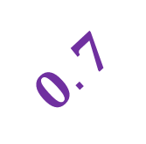




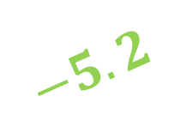

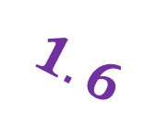




$$b$$
$$1.6$$
$$0.5$$
$${ z}_{1}$$
-$0.1$
$${ z}_{3}$$
ReLU
$$−2.5$$
2.4
$$−1.5$$
-2.2
$${ z}_{4}$$
$$0.6$$
$$1.5$$
$$−5.2$$
$$0.37$$
$${ z}_{2}$$
$${ z}_{5}$$
ReLU
$$0.4$$
$$3.7$$
$$0.7$$
$$1$$
$$b$$
$$b$$
Input Layer
Hidden Layer
Output Layer

Slide 47



$$b$$
$$1.6$$
$$0.5$$
$${ z}_{1}$$
-$0.1$
$$1.43$$
ReLU
$$−2.5$$
2.4
$$−1.5$$
-2.2
$$−0.4$$
$$0.6$$
$$1.5$$
$$−5.2$$
$$0.37$$
$${ z}_{2}$$
$$0.23$$
ReLU
$$0.4$$
$$3.7$$
$$0.7$$
$$1$$
$$b$$
$$b$$
Input Layer
Hidden Layer
Output Layer

Slide 48
$$b$$
$$1.6$$
$$0.5$$
$${ z}_{1}$$
-$0.1$
$$1.43$$
ReLU
$$−2.5$$
2.4
$$−1.5$$
-2.2
$$−0.4$$
$$0.6$$
$$1.5$$
$$−5.2$$
$$0.37$$
$${ z}_{2}$$
$$0.23$$
ReLU
$$0.4$$
$$3.7$$
$$0.7$$
$$1$$
$$b$$
$$b$$

Slide 49
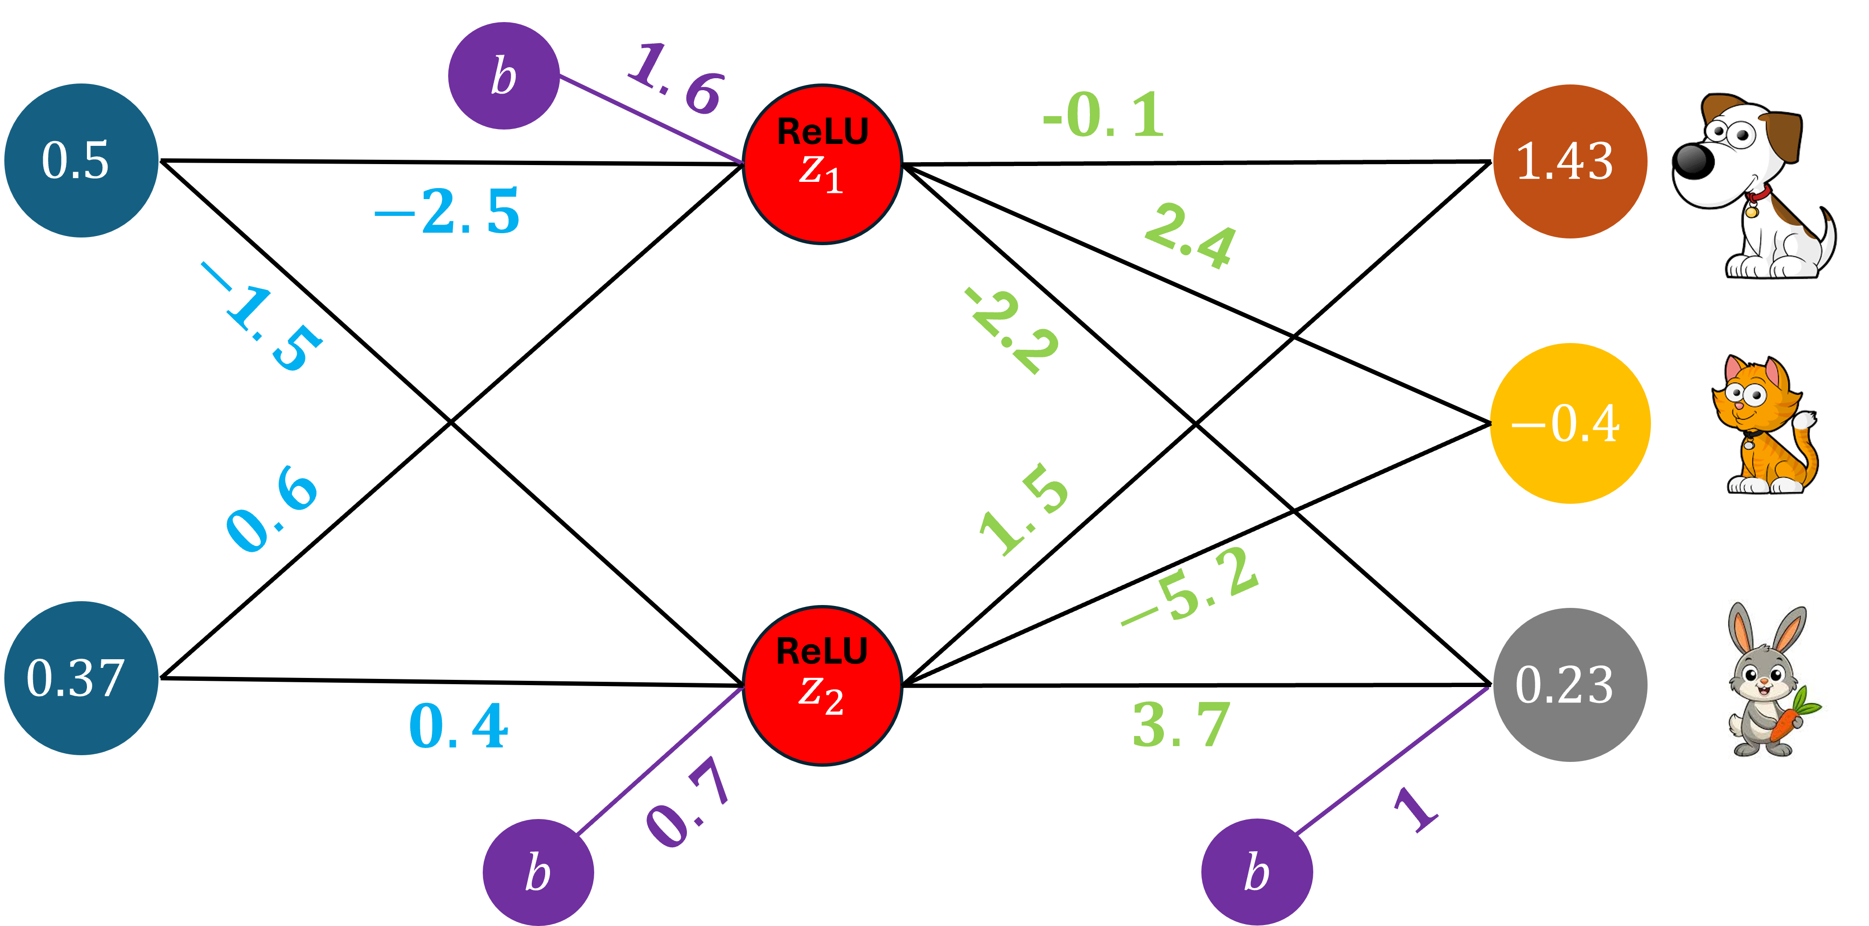
When we calculated for the raw outputs of our neural network, notice that they have a broad range of values that is hard to interpret.

Slide 50
And this is one of the reasons that, when there is more than one output.

Slide 51



$$argmax$$
The raw outputs are sent to either an ArgMax layer

Slide 52



$$SoftMax$$
Or a SoftMax layer before a final prediction is made

Slide 53
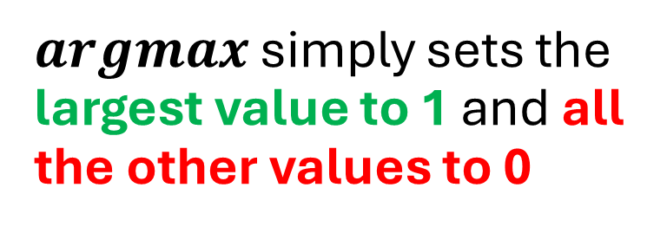
$$argmax$$
$argmax$ simply sets the largest value to 1 and all the other values to 0

Slide 54
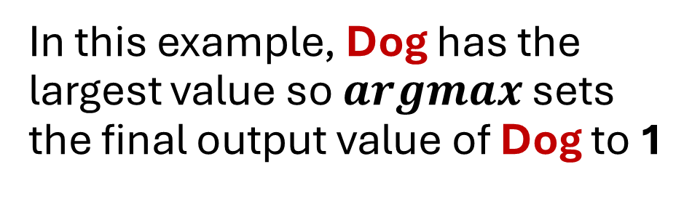


$$1$$
$$argmax$$
In this example, Dog has the largest value so $argmax$ sets the final output value of Dog to 1

Slide 55




$$1$$
$$argmax$$
$$0$$
$$0$$
And the final output values of Cat and Rabbit to 0

Slide 56
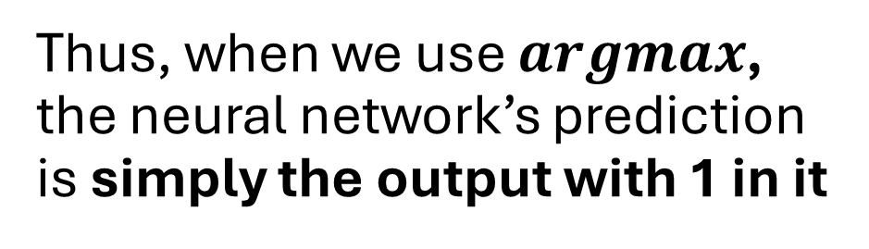

$$1$$
$$argmax$$
$$0$$
$$0$$
Thus, when we use $argmax$, the neural network’s prediction is simply the output with 1 in it

Slide 57
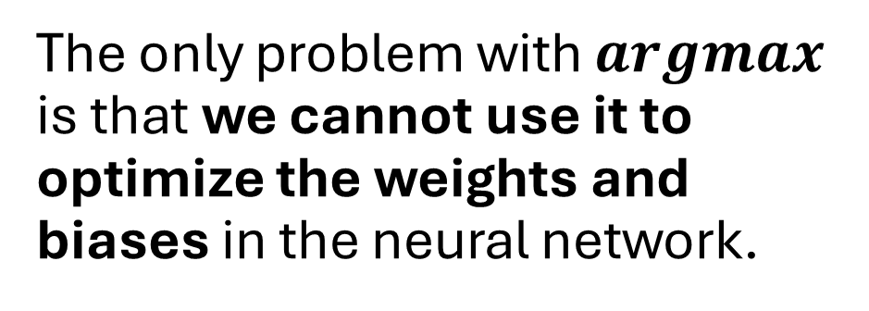
$$1$$
$$argmax$$
$$0$$
$$0$$
The only problem with $argmax$ is that we cannot use it to optimize the weights and biases in the neural network.

Slide 58
$$1$$
$$argmax$$
$$0$$
$$0$$
Which we will do when performing backpropagation.

Slide 59
$$SoftMax$$
So that leads us to the SoftMax function

Slide 60
$$SoftMax$$
Let us see the SoftMax function in action!

Slide 61


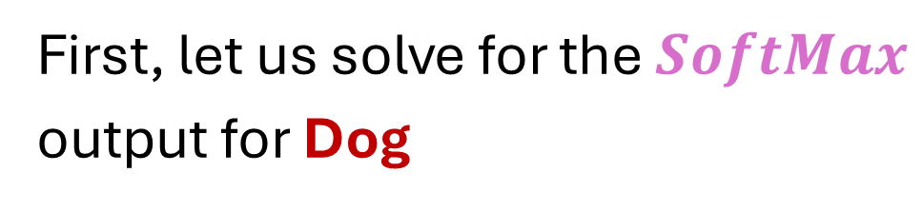


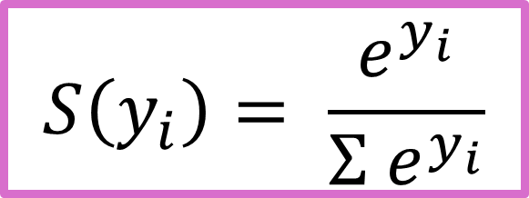
First, let us solve for the $SoftMax$
output for Dog
$$S\left(y_{i}\right)= \frac{e^{y_{i}}}{{Σ e}^{y_{i}}}$$
$$SoftMax$$
$$S_{Dog}= \frac{e^{Dog}}{e^{Dog}+e^{Cat}+e^{Rabbit}}$$

Slide 62
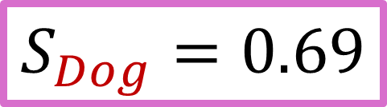
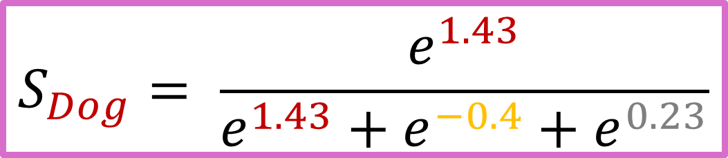
$$S_{Dog}= \frac{e^{1.43}}{e^{1.43}+e^{−0.4}+e^{0.23}}$$
$$S_{Dog}=0.69$$
$$SoftMax$$

Slide 63

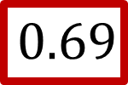

$$0.69$$
$$SoftMax$$

Slide 64
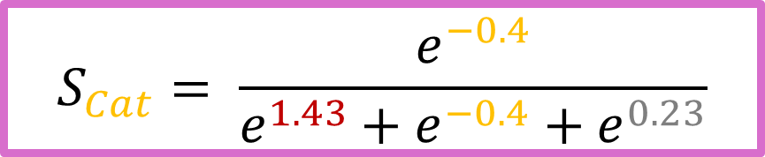
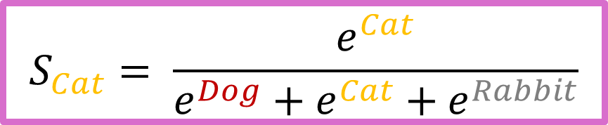
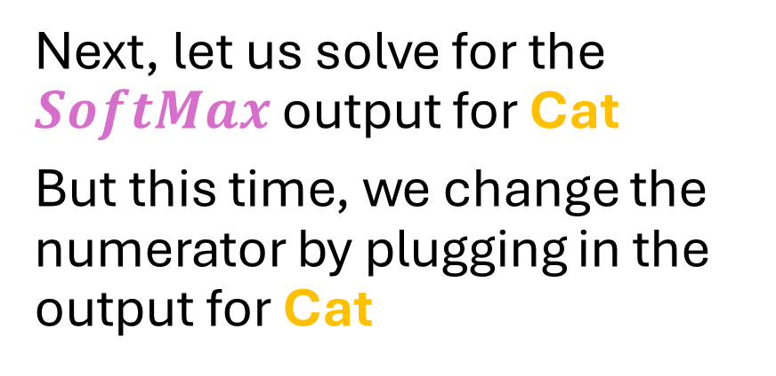

Next, let us solve for the $SoftMax$ output for Cat
But this time, we change the numerator by plugging in the output for Cat
$$0.69$$
$$SoftMax$$
$$S_{Cat}= \frac{e^{Cat}}{e^{Dog}+e^{Cat}+e^{Rabbit}}$$
$$S_{Cat}= \frac{e^{−0.4}}{e^{1.43}+e^{−0.4}+e^{0.23}}$$
$$S_{Cat}=0.10$$

Slide 65
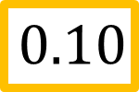
$$0.69$$
$$SoftMax$$
$$0.10$$

Slide 66
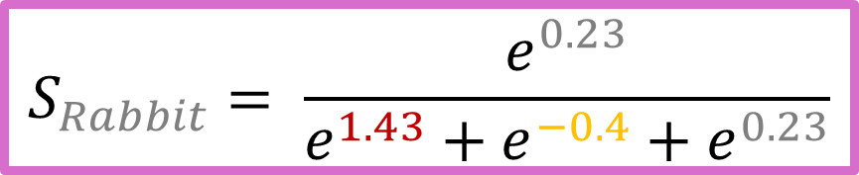

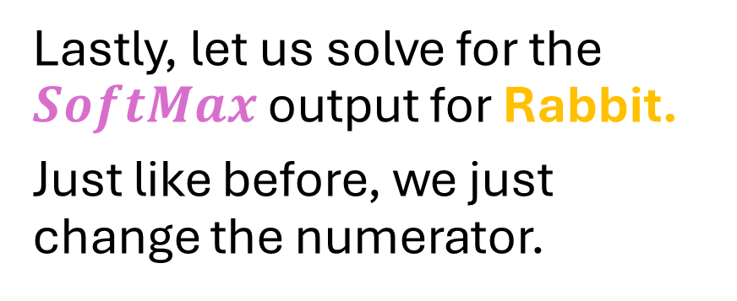
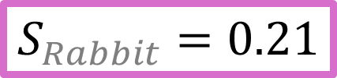
Lastly, let us solve for the $SoftMax$ output for Rabbit.
Just like before, we just change the numerator.
$$0.69$$
$$S_{Rabbit}= \frac{e^{Rabbit}}{e^{Dog}+e^{Cat}+e^{Rabbit}}$$
$$SoftMax$$
$$0.10$$
$$S_{Rabbit}= \frac{e^{0.23}}{e^{1.43}+e^{−0.4}+e^{0.23}}$$
$$S_{Rabbit}=0.21$$

Slide 67

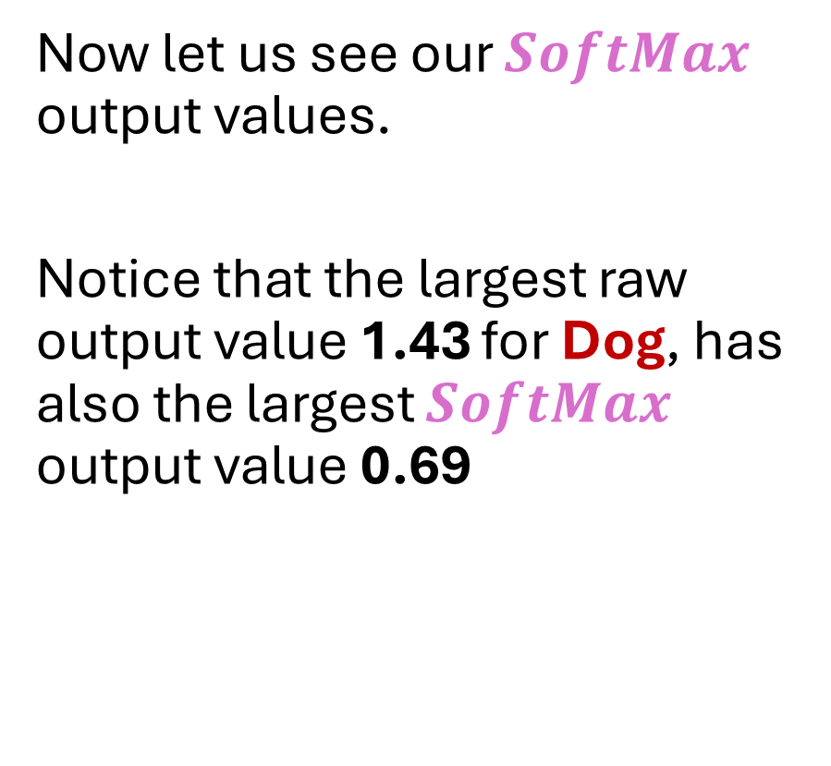
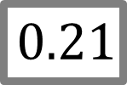
Now let us see our $SoftMax$ output values.
Notice that the largest raw output value 1.43 for Dog, has also the largest $SoftMax$ output value 0.69
$$0.69$$
$$SoftMax$$
$$0.10$$
$$0.21$$

Slide 68

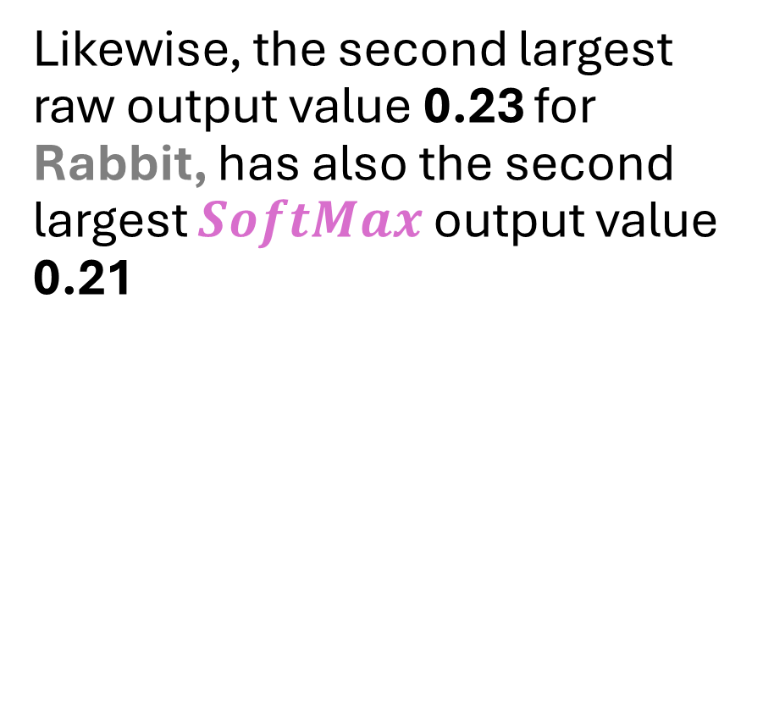
Likewise, the second largest raw output value 0.23 for Rabbit, has also the second largest $SoftMax$ output value 0.21
$$0.69$$
$$SoftMax$$
$$0.10$$
$$0.21$$

Slide 69

Lastly, the lowest raw output value -0.4 for Cat, has also the lowest $SoftMax$ output value 0.10
$$0.69$$
$$SoftMax$$
$$0.10$$
$$0.21$$

Slide 70

So we see that $SoftMax$ preserved the original order or ranking of the original raw output values.
Also, notice that the $SoftMax$ output values are between 0 and 1
$$0.69$$
$$SoftMax$$
$$0.10$$
$$0.21$$

Slide 71

This is what $SoftMax$ ensures regardless of how many raw output values there are.
The $SoftMax$ output values will always be between 0 and 1
$$0.69$$
$$SoftMax$$
$$0.10$$
$$0.21$$

Slide 72

And notice that if we add up all of the $SoftMax$ output values
$$0.69 + 0.10 + 0.21=1$$
The total is 1. $SoftMax$ output values can be interpreted as predicted probabilities.
$$0.69$$
$$SoftMax$$
$$0.10$$
$$0.21$$

